Slide 1
The Count of Monte Cristo
Class discussion guide

Slide 2
The Pharoan and Edmond Dantes
The novel begins with the Pharoan returning to Marseilles, its home port
  This is metaphorical in nature
  Arriving in the port suggests a beginning
Who is the young man guiding the ship with its pilot?
Why has taken on this leadership role? What happened to Captain Leclere?
  How has the young man done in this role?
Danglars – purser, jealous of Dantes; mentions stopping at Elba and the letter
Morrel – owner of Pharoan
Allusion to Isle of Elba - foreshadowing

Slide 3
Dantes’ Relationships
Describe his relationships with:
  His crew
  His father
  Mercedes
What do these relationships reveal about his character?

Slide 4
Key Characters
Who are Caderousse, Danglars, and Fernand? Describe the attitude of each toward Dantes.
What is the function of these characters in the novel?
Notes:
Dantes acts coldly toward Caderousse because of his mistreatment of Dantes’ father
Danglars is jealous and bitter over Dantes appointment as ship captain
Dantes recognizes Fernand as an enemy because his jealousy regarding Mercedes
Caderousse and Danglars meet outside Dantes’ apartment and exchange words reflectiong their mutual interest in Dantes’ affairs. They meet Fernand after his angry departure from Mercedes and Dantes and manipulate him with flattery to arouse his jealousy. The three form a conspiracy against Dantes.
Each is present at the betrothal feast and their actions allude to this conspiracy

Slide 5
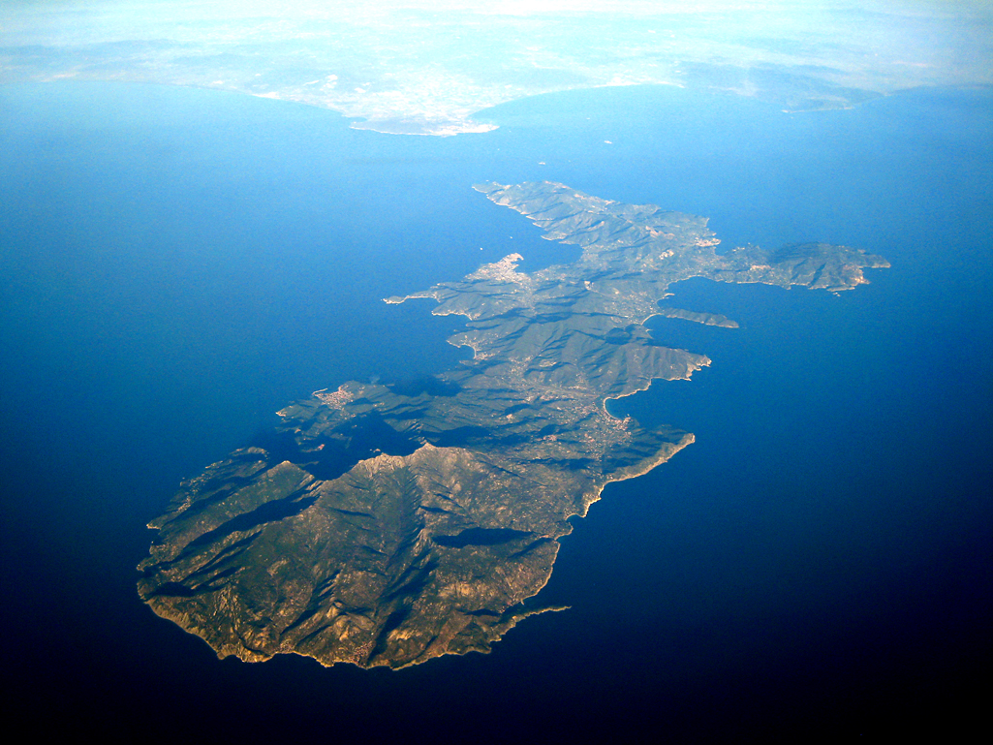
One Fatal Stop
Describe how the Pharoan’s stop at Elba has become important to the story.
Reminder: Historical Significance of Elba
Analyze the implications of Dantes’ arrest as a Bonapartist agent
  What might happen to Dantes? To his father? To Mercedes?
Notes:
Tensions were high in 1815, and anyone thought to be associated with Napoleon would be suspected of conspiring against King Louis XVIII. If convicted of being a Bonapartist agent, Dantes will face death or imprisonment

Slide 6
The Count of Monte Cristo
pp. 29-58

Slide 7
Villefort
Describe Villefort and discuss his relationship with his father
  What is his relationship with Renee?
  What is the Deputy Procureur du Roi?
Analyze Villefort’s inquisition of Dantes and why he sends him to prison
  When Villefort burns the letter, Dantes believes this is helpful to him. How does he misread Villefort’s motivation?
Notes:
Villefort is deputy magistrate, 27 years old, loyal to King Louis XVIII, and engaged to a beautiful, wealthy girl. His father, Noirtier, is a Bonapartist who had been a senator under Napoleon. Villefort has distanced himself from his father and discarded the name Noirtier. Villefort must watch his own actions carefully because of the suspicions surrounding his father.
Villefort is impressed with Dantes’ answers to his questions and believes Dantes has been falsely accused because of jealousy but is loyal to the king. When he learns that the letter Dantes received on the Isle of Elba is addressed to Noirtier, Villefort realizes the precariousness of his position. Terror of losing his position and being accused of Bonapartist sympathies cause Villefort to burn the letter and send Dantes to prison.

Slide 8
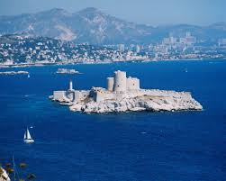
Chateau D’if
Describe the Chateau D’if
Describe its effect on Dantes
Notes:
Only important political defendants are sent to the prison. Its name brings terror to those who are condemned to go there. Dantes tries hopelessly to hurl himself into the sea. His initial cell is a damp underground room, and he cannot eat or sleep. His repeated demands to see the governor cause him to be transferred to the dungeon where madmen are placed.

Slide 9
Political Climate
How do you know the political climate is very uncertain during this time period?
  Specific examples!
How does Villefort misrepresent Dantes?
What does the King say about Villefort?
  “…he would sacrifice everything to gain his own end, even his father.”
Notes:
King Louis XVIII has heard rumors about Napoleon’s return but discounts their validity. Villefort arrives with information from the letter Dantes had been asked to deliver to Noirtier in Paris, and the King learns that Napoleon has left the Isle of Elba with three manned vessels. Villefort misrepresents Dantes’ role and implies that he, Villefort, arrested Dantes and forced him to reveal the verbal message he was to deliver. A delayed telegram confirms that Napoleon has landed in France. During the King’s discussion with his Minister of Police about the murder of an important general, Villefort realizes that Noirtier, his father, is the murderer. The King recognizes Villefort’s loyalty and rewards him with the cross of the Legion of Honor. After Napoleon’s victory, Villefort retains his position because of the influence of his father. When King Louis XVIII regains power, Villefort is promoted to Procureur du Roi. Villefort demonstrates his loyalty to whatever cause will benefit him most.

Slide 10
Significant Reactions
How does each of the following react to the news of Dantes’ imprisonment?
  Mercedes
  Fernand
  M. Morrel
  Caderousse
  Danglars

Slide 11
The Count of Monte Cristo
pp. 58-91

Slide 12
Historical Events and Their Impacts
How do real historical events impact Dantes’ life negatively but Villefort’s positively?
  How does Danglars react to the return of Napoleon?
  What does Fernand do?
  What happens to Dantes’ father?
  How do we know Mercedes is devastated?

Slide 13
Dantes’ Prison Mentality
Analyze Dantes’ prison mentality which moves him from despair to hope.
  Why is he so astonished at the sound of another human voice?
  How does Dantes, once so full of life, come to welcome death?
  Why does he decide to starve himself rather than hanging?
  What – almost literally – pulls him back from death?
Notes:
Elicit student response to the value of “little things” and the importance of human contact
At first he unsuccessfully prays to his jailers. When that fails, he turns to God but begins to scream blasphemies when he remains a prisoner. He begins to plot vengeance against the men who were instrumental in his imprisonment. He longs for death and decides to starve himself. As death approaches, Dantes hears a sound that indicates another human is digging to get to his cell. Despair turns to hope. He becomes grateful to God for simple things such as the iron handle of a saucepan. Dantes begins to dig toward the other prisoner and to cry out for God’s help.

Slide 14
Abbe Faria
Describe the Abbe Faria and his impact on Dantes
  Explain the passage on page 74
  Why is Faria discouraged?
  How does Faria help Dantes understand what has happened to him? (pp. 80-84)
  What terrible resolution has Dantes made? (p. 84)
  Why does Faria regret having helped Dantes?
  How does their escape plan go astray?
  What oath does Dantes make to Faria?
Notes:
Abbe Faria, and Italian scholar who appears to be in his middle sixties, has been a political prisoner since 1807 and has been in Chateau d’If since 1811. He is ingenious, having made paper and quills and having devised methods to write volumes of his thoughts. It took him four years to make tools, and he has been digging for two years, thinking he was digging toward the outside wall of the prison. Although he is disappointed when he realizes he has been digging toward Dantes’ cell, they delight in each other’s company. Dantes has renewed hope and faith. They begin planning to escape together. The abbe guides Dantes as he explores who is responsible for his imprisonment and why: Danglars, who was jealous and wrote the anonymous letter to Villefort, Franand who wanted Mercedes, and Villefrt whom the abbe recognizes as the son of Noirtier. Dantes vows vengeance on them all.

Slide 15
Comparisons
On page 62, explain the difference in character between Villefort and his father Noirtier.
How is the father/son relationship dynamic furthered in this reading section?
Abbe Faria is surprised by Dantes’ loyalty. Are you?
  What important thing might he have to tell Dantes?

Slide 16
The Count of Monte Cristo
pp. 91-126

Slide 17
Faria’s Past
What does Faria reveal about his past?
What does he reveal about the treasure?
Notes:
The abbe has a cataleptic fit when he and Dantes are preparing to escape. Dantes vows he will never leave the abbe alone but will help him escape from prison. The abbe shows Dantes a portion of a will from the murdered Caesar Spada, left in a breviary he bequeathed to the abbe. One third of it had been destroyed by fire, but the abbe has been able to supply the missing words and discover directions to hidden treasure on the Isle of Monte Cristo. The abbe was arrested and imprisoned before he could search for the treasure. He calls Dantes the “child of his captivity” and has Dantes memorize the instructions and tells him they will each have half of the treasure or, if the abbe dies, it will all belong to Dantes

Slide 18
Escape!
Describe Dumas’ use of coincidence in the matter of Dantes’ escape.
Analyze the implications of Dantes’ escape.
What elements of the Romantic/adventure story do we encounter in this section?
Why does Dumas have Dantes escape during a storm?
Notes:
The abbe has a third attack and dies, despite Dantes’ valiant efforts to savehim. The jailers place the body in a cloth bag. Dantes re-enters the abbe’s cell, removes the body and takes it to his own cell, then gets into the bag and sews it back together. He plans to cut his way out after he is placed in the grave. The bag is thrown into the sea with a cannonball weight, and Dantes barely escapes his watery grave;
Coincidences – the abbe is buried at night when Dantes’ trickery will be least detectable, Dantes cuts the cord around his feet just in time, he sees five fishermen clinging to a boat that crashes against the rocks, killing all five, he retrieves the cap of one as a disguise. The crew of a smuggler ship that saves him accepts his explanation of the firing of the cannon at Chateau d’If, the skipper of the ship chooses the Isle of Monte Cristo to unload his cargo
Baptism – transformation to Count of Monte Cristo. He has languished in prison for 14 years, becoming bitter and suspicious as he plots vengeance against his enemies. He has lost his youth, his innocence, and his plans for the future. He is now deceitful and filled with the desire for revenge. Lying comes easily to him during his first interaction with humans, and this sets the stage for his future. Instead of a rebirth to a new, better life, Dantes is a baptism of death – death of his conscience, his integrity, and his compassion

Slide 19
The Count of Monte Cristo
pp. 126-155

Slide 20
Treasure! Homecoming!
Discuss Dantes’ discovery of the treasure on the Isle of Monte Cristo and analyze the ongoing changes in him since his escape from prison,
Describe Dantes’ return to France and examine what he learns about the principal characters in his life prior to his imprisonment.
  Identify his pseudonym and examine its effectiveness
  Why does Mercedes marry Fernand, according to Caderousse?
  Who is Mercedes’ son?
  What do you think Dantes’ feelings toward Mercedes are?
  Describe Caderousse’s role in this scheme. Why does Dantes “forgive” him?
Notes:
He pretends to be seriously injured and insists that the crew of the Jeune Amelie leave him on the island. He discovers the location of Spada’s cave and uses gunpowder to blast away the surface rock. He discovers untold wealth in a wooden chest
Changes – he had previously wanted only liberty, but now desires riches. He has become deceptive. He wants no one around him, lies about being injured, and lies about his sudden wealth
A shipmate first goes to Marseilles and reports to Dantes the news of his father’s death and Mercedes’ disappearance. Dantes returns to France, disguised as a priest in whom Dantes had confided before his death, asking him to “remove the tarnish from his name.” Dantes encounters Caderousse, entices him with a diamond, and manipulates him into relating the events leading to and following Dantes’ imprisonment. Dantes’ father died of grief and hunger. Morrel attempted to clear Dantes’ name and took care of his father. Fernand and Danglars betrayed Dantes, Fernand for love of Mercedes and Danglars because of jealous ambition. Danglars wrote the defamatory letter and Fernand mailed it. Caderousse kept silent. Mercedes married Fernand and has a son, Albert. Morrel faces bankruptcy. Danglars and Fernand, now the Count of Morcerf, are wealthy. Caderousse lives in poverty.

Slide 21
False Identities
Why does Dantes assume the identity of the Englishman?
What may his use of false identities suggest about him?
  Note the irony on p. 153
    “He made a deep impression on me and I shall never forget his face.”
What does he learn about Morrel?
What does he learn about Villefort?

Slide 22
The Count of Monte Cristo
pp. 155-189

Slide 23
Morrel and His Misfortunes
What has he been through?
How do you know he is an honorable man?
What is his son’s reaction to his plan to maintain his honor?
Given a reprieve by the agent from French and Thomsen (Dantes), how does Morrel try to save his business and reputation?
  What response does he get? Why are we not surprised?
How does Dumas demonstrate coincidence in this part of the novel?
What is the point of saving Morrel’s life at the last possible moment?
Why is this part of the Romantic novel?
What additional good news does Morrel receive?
So far, how has Dantes used his fortune?
Notes:
Morrel is honest and fulfills his obligations promptly even when he must sell personal belongings to do so. He appeals to Danglars, who refuses to help him. His shipyard is almost deserted, and only two employees remain. Filled with anxiety, he pins his last hopes on the return of the Pharoan. When he discovers the ship is lost, he submits to “God’s will” and pays the crew with his last money. Dantes gives him a reprieve. Morrel later plans to commit suicide rather than fail to keep his word.
Maximillian, the son, and Julie, the daughter, love and respect their father and are willing to do anything they can to save the company. Maximilian accepts his father’s suicide solution and vows to redeem the family name. It is through Julie that Sinbad the Sailor assists Morrel.

Slide 24
Morrel’s Children
What kind of children does Morrel have?
Describe Maximilian and Julie
Why does Dantes use the red silk purse?
What is inside?
What sort of fellow is Emmanuel?
Notes:
Maximillian, the son, and Julie, the daughter, love and respect their father and are willing to do anything they can to save the company. Maximilian accepts his father’s suicide solution and vows to redeem the family name. It is through Julie that Sinbad the Sailor assists Morrel.

Slide 25
Shift in Focus
What does Dantes mean when he says, “Farewell to all the sentiments which rejoice the heart. I have played the part of Providence in recompensing the good. May the god of vengeance now permit me to punish the wicked!”
Notes:
He has fulfilled a vow to repay Morrel’s goodness and will no longer play the part of Providence in recompensing the good but will act as the god of vengeance to punish the wicked. He will avenge himself against Villefort, Danglars, Fernand, and Mercedes.

Slide 26
Albert’s Interest in Rome?
What seems to be Albert’s chief interest in Rome?
How does this get him into real trouble?
How do we see the Count’s fingers in the action here?

Slide 27
Additional Identity
Why does Dantes want to keep his true identity a secret?
What kind of man does he present himself as when claiming to be the Count of Monte Cristo?
Why does he approach Albert and his companion?
Why are these young men in Rome?
  Who is Luigi Vampa and why will he become important?
  Why does Dumas take us to Rome during the time of Carnival?
Notes:
The Count of Monte Cristo is immensely rich, handsome, supposedly Sicilian or Maltese, generous, gentlemanly, has informants in the Pope’s palace in rome, and is powerful. He offers Morcerf and d’Epinay his friendship and gives them access to his transportation and accomodations.

Slide 28
The Count of Monte Cristo
pp. 189-217

Slide 29
Debt and Vengeance
How does the Count make Albert indebted to him?
  What is his purpose in doing so?
What is revealed about the Count’s idea of vengeance?
  He could obviously hire an assassin, but doesn’t. Why not?
Discuss Franz’ reaction to the Count
Notes:
The Count rescues Albert, who has been kidnapped by Luigi Vampa, a bandit. Vampa releases Albert to the Count in exchange for a delay on Peppino’s execution. Monte cristo asks Albert, whom he now knows is the son of Fernand and Mercedes, to introduce him in Paris.

Slide 30
New Characters
Peppino – aka Rocco Priori
Andrea Rondolo
Bertuccio and Ali – servants to MC
Teresa – the incognito Vampa’s girlfriend
Beppo – Vampa’s man disguised as a girl
Gregory XVI – current Pope

Slide 31
The Count of Monte Cristo
pp. 218-249

Slide 32
Visiting Paris
Describe Monte Cristo’s visit to Albert in Paris
Whom does Monte Cristo meet at the home of Albert?
How has Dantes’ life been different from that of Fernand and Mercedes?
What do we learn about Maximilian and Julie?
Notes:
Albert’s parents, Mercedes and Fernand, are making preparations to honor Monte Cristo. The Morcerfs have attained wealth, a beautiful home, and societal influence. By contrast, Dantes, although now wealthy, spent many of the past years in a prison dungeon, with meager food and only one friend. The section reintroduces Maximilian Morrel as a friend of Albert, and Albert alludes to Danglars and his family. Monte Cristo learns from maximilian that Julie and Emmanuel are married. He observes a portrait of Mercedes as he remembers her and is introducedto Fernand and Mercedes. Monte Cristo observes secret grief in Fernand’s careworn features. Mercedes experiences a strange terror, probes Albert about Monte Cristo, and cautions him to be careful.

Slide 33
Mercedes and Monte Cristo
How does Mercedes feel about Monte Cristo when she sees him again?
Why does Mercedes ask Albert if he trusts Monte Cristo?
Why does she make no move to recognize him?

Slide 34
Danglars and Monte Cristo
What business dealings does Monte Cristo undertake with Danglars?
What is the significance of the purchase of Danglars’ horses?
Notes:
Monte Cristo’s ability to manipulate the Danglars is obvious throughout this section. Danglars is reluctant to issue unlimited credit for Monte Cristo, but agrees to do so when the Count alludes to other firms who will be glad to honor his request. They settle on the sum of six million for the first year, an amount that astonishes Danglars. Monte Cristo purchases Danglars grappled grey horses, which actually belong to Madame Danglars, for a phenomenal sum, causing her to become violently angry. Thus, he achieves his objective: destroying the peace in the family and enabling him to win the Danglars’ gratitude by returning the horses.

Slide 35
New Characters
Lucien De Bray – private secretary to the minister of the interior
Beauchamp – an editor
Renaud – Albert’s friend
Max Morrel
  Max saves Renaud’s life - resurrection

Slide 36
The Count of Monte Cristo
pp. 249-276

Slide 37
Danglars’ Horses
What happens involving the Danglars’ horses?
Why do you think this is significant?

Slide 38
Haydee
Identify Haydee
What is revealed about her?
Notes:
Haydee is a beautiful Greek girl whom the Count rescued from the slave market. He assures her she is free, but she considers herself to be his slave. She is content to live secluded and expresses deep love for him. He cautions her not to reveal the secret of her birth.

Slide 39
Visiting Max
What does Monte Cristo discover when he visits Maximilian Morrel?
Explain the irony in the conversation.
Morrel realized at the end who their benefactor was.
Monte Cristo creates another identity – what is it? Why?
Notes:
Julie is happily married to Emmanuel, her father’s former clerk, where Monte Cristo sees the purse from Sinbad the Sailor. Julie and Maximilian reveal the deeds of and their gratefulness toward their “angel” – whom their father believed to be Edmond Dantes. Irony- they are talking to the angel

Slide 40
Visiting Villefort
Identify and describe the people Monte Cristo meets in the home of Villefort
How does Monte Cristo’s plotting continue?
Notes:
Monte Cristo meets Villefort’s children: Valentine, who is betrothed to Albert, and Edward. He learns that Noirtier, Villefort’s father, lives with them but is completely paralyzed. He recalls to Madame de Villefort a prior meeting when the discussed the poison brucine, and he gives her some of the poison. This chapter foreshadows Madame de Villefort’s poisoning several people, including her own son.
Monte Cristo plans to further his revenge by introducing them to the Cavalcantis, who will manipulate the two families financially and personaly, and does not wish to involve or hurt Mercedes. He alludes to his desire to attain Mercedes’ esteem.

Slide 41
New Characters
Heloise Villefort – Edward is her son
Haydee
Valentine

Slide 42
The Count of Monte Cristo
pp. 279-305

Slide 43
Furthering Relationships
What is the relationship between Mercedes and Madame Danglars?
Whom does Monte Cristo plan to invite for dinner at his home?
  Whom does he plan to exclude? Why?
How do each of the following characters feel about Valentine’s impending marriage to Franz: Valentine, her father, Madame de Villefort, Noirtier?
Characterize Madame Villefort’s feelings for her son
What does this section suggest about the role of marriage among wealthy families of the time?
Notes:
Valentine de Villefort loves Maximilian Morrel; Eugenie Danglars is betrothed to Albert de Morcerf but does not love him; Noirtier, Villefort’s father, lives in the Villefort home. Maximilian tells the Count about his love for Valentine.
Noirtier and Franz’s father were political enemies, and Noirtier opposes the marriage. Villefort feels it is a good move politically and will allay suspicions about Villefort’s suspected involvement in the assassination of Franz’s father. Madame de Villefort secretly hopes the marriage will not occur.

Slide 44
Revenge, revenge, revenge…
What does the Count continue to do?
Notes:
He sends a telegram, reprinted in the newspaper, that causes Danglars to lose a million francs; he arranges a meeting between Danglars and the imposters Cavalcanti and his son. Chapter 65 reveals how this leads to Danglars’ further financial ruin and Eugenie Danglars’ disgrace because of Andrea de Cavalcanti.

Slide 45
The Count of Monte Cristo
pp. 305-332

Slide 46
Danglars’ Loss of Wealth
Analyze the Count’s role in the loss of money for Danglars.
Notes:
The Count sends a telegram, reprinted in the newspaper, that causes Danglars to lose a million francs; he arranges a meeting between Danglars and the imposters Cavalcanti and his son. Chapter 65 reveals how this leads to Danglars’ further financial ruin because of Andrea de Valvalcanti

Slide 47
Auteuil
Describe the Count’s house at Auteuil.
  Why is the show of wealth such an important part of the Count’s revenge?
Explain the irony of the Count’s statement on p. 316: “I expend as much perseverance in the pursuit of a whim as you…”
Notes:
Note the fish – irony…

Slide 48
Albert and Eugenie
How does the Count meddle in the matter of the matrimony between Albert and Eugenie?
  Who are the Cavalcantis?

Slide 49
Debray and Madame Danglars
Explain the relationship between Debray and Madame Danglars
Describe the relationship between Danglars and his wife
What is the significance of the fact that Fernand, Danglars, and Villefort seem unhappy in their married lives?

Slide 50
The Count of Monte Cristo
pp. 332-353

Slide 51
Summer Ball
What happens at the summer ball at the Morcerfs?

Slide 52
St. Meran
What are the implications of the death of St. Meran?

Slide 53
Mercedes and Dantes
How do you know Mercedes recognizes Dantes?

Slide 54
Valentine’s Grandmother
What is implied about the illness of Valentine’s grandmother? Explain.
Why is Valentine’s grandmother so intent on her marriage taking place quickly?

