Slide 1
The Crucible
By Arthur Miller

Slide 2
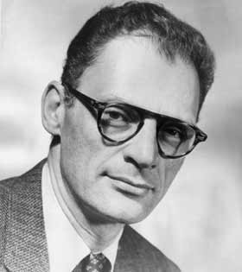
The Playwright
Arthur Miller is a famous American playwright. He examines disillusioned characters and the individual conscience vs. the mob in much of his work.
The Crucible opened in New York, NY in 1953
It tells the story of the Salem Witch Trials of 1692.
The play is also an allegory of the “witch-hunts” of the House Un-American Activities Committee (HUAC) led by Senator McCarthy in the 1950s.
http://1.bp.blogspot.com/_mbWThvBk2kA/SM_VbpqdO1I/AAAAAAAAGd8/gFC7uw2lsVs/s320miller.jpg

Slide 3
Salem Witch Trials
In writing The Crucible, Miller went to the source of the Salem Witch Hunts and read transcripts of the trials. His play is not historically accurate, but does loosely follow the real events.
In 1692 nineteen men and women and two dogs were convicted and hanged for witchcraft in Salem, MA.
In 1957 the Massachusetts government passed a resolution absolving the descendents of the accused “of disgrace or distress.”
In 1992, 300 years later, the names of those who suffered were added to the resolution.
Why did it take so long for the court to acknowledge its full responsibility?
What happens when authority is challenged?

Slide 4
Allegory
An allegory acts as an extended metaphor.
An allegory tells a story that has characters, setting and symbols with both literal and figurative meanings.
The difference between an allegory and a symbol is that an allegory is a complete story that conveys abstract ideas to make a point, whereas a symbol is a representation of an idea that can have different meanings throughout a literary work.

Slide 5
Allegory of McCarthyism
Americans in the 1950s were afraid of Communism and nuclear weapons. Russians had developed a nuclear bomb, and American feared annihilation. This fear made them vulnerable and led to accepting leadership they shouldn’t have.
Joseph McCarthy was that leader - a republican senator from Wisconsin. He spent his first three years in office “undistinguished.”
Some described him as a “lazy and ineffectual senator, and an easy captive for any lobbyist willing to put a few extra bucks into his personal or political bank account.”
He sought fame and power.
His political career was fading, until he used the charged political climate to boost that career.

Slide 6
Allegory of McCarthyism
It is widely accepted that McCarthy made up falsely accused people of promoting Communism solely to increase his political power.
Many people were willing to believe his charges without evidence because people wanted to feel secure. His focus on weeding out corruption made people feel that someone was doing something to keep them safe.
McCarthy became the most sought-after public speaker in America. He was named one of Washington’s most eligible bachelors. His office was flooded with donations to help his cause of eliminating the communist threat. At one point, he received an average of $1000.00 a day in the mail.
Eventually, he had to escalate his accusations and not just speak generally of government officials, but actually NAME NAMES. He branched out to intimidate and attack private citizens– journalists, professors, artists, and those in professions that were considered “LIBERAL.”
( Oakley )

Slide 7
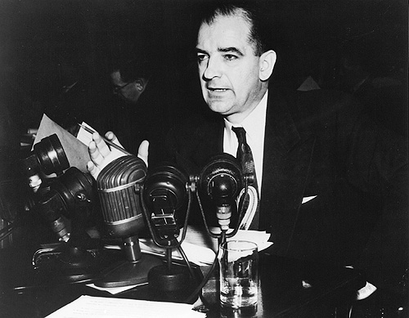
Salem-Washington Parallels
According to Miller:
Both were ritualistic hearings.
The accused make public confessions, damn friends and the Devil, and guarantee allegiance by breaking old vows.
Then, the accused are free to rejoin society of decent people.
http://www.archives.gov/exhibits/treasures_of_congress/Images/page_23/70b.jpg

Slide 8
Why An Allegory?
Miller writes: “‘The reason I think that I moved in that direction was that it was simply impossible any longer to discuss what was happening to us in contemporary terms. …The hysteria in Salem had a certain inner procedure or several which we were duplicating again, and that perhaps by revealing the nature of that procedure some light could be thrown on what we were doing to ourselves. And that’s how the play came to be’” (Bigsby xii).

Slide 9
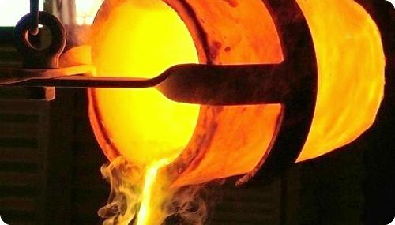
Crucibles
“One dictionary definition of a crucible is a place of extreme heat, ‘a severe test’” (Bigsby xvi).
As we read, watch for instances in the play where a prop, setting, or action contains the symbol of a crucible.
http://www.rojan.com.au/cache/path/:upload:pages:foundry-crucibles-accessories:mammut-crucibles-in-action1.jpg/crop/1/width/500/height/285/round/15/name/mammut-crucibles-in-action1.jpg

Slide 10
Themes: A Play About Power
This play explores:
The mechanisms by which power is maintained, challenged, lost
The seductiveness of power
The power of guilt
How power equals the ability to determine what is real
The power of life and death

Slide 11
Themes: A Play About Perfection
The Puritans: A city on a hill.
Belief in unique virtues.
Society that seeks to sustain a dream of perfection by denying all possibility of imperfection.
“Evil can only be external, for theirs is a city on a hill” (Bigsby xxv).

Slide 12
A Tragedy
A tragedy is a story wherein individuals confront powerful forces and reveal the depth of human nature even the face of failure.
A tragic flaw is an error or defect that leads to the downfall of the hero.
This play is a tragedy for an individual and a tragedy for a community.

