Slide 1
Cyrano de Bergerac
Act V

Slide 2
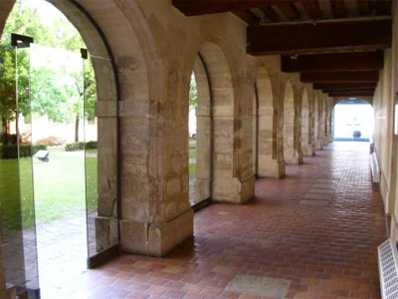
Scene Change!
15 years later
Ladies of the Cross Convent in Paris

Slide 3
Act V scene i
Mother Marguerite, Sister Marthe, Sister Claire, other Nuns
Questions
  Why do the nuns love Cyrano?
  How would you describe their interactions?
Notes
  Cyrano is still poor, and still too proud to ask for help
  Marshal Duke de Grammont is Count de Guiche’s new title

Slide 4
Act V scene ii
Roxane, Duke de Grammont, Le Bret, Ragueneau, a Nun
Questions
  How does Roxane feel about her life?
  Should we feel sorry for Cyrano? The Duke says no…
  How has the Duke changed? What does he think of Cyrano’s way of life now?
  What has happened to Ragueneau over the years?
Notes
  Irony in Roxane’s statement that “He [Christian] showed his true nature only to those who knew him well.”
  Roxane’s “eternal tapestry” – Penelope!
  Cyrano hasn’t changed

Slide 5
Act V scene iii
Le Bret, Ragueneau
Questions
  What news does Ragueneau bring?
  What is Le Bret’s plan?
  What does Roxane assume is happening?

Slide 6
Act V scene iv
Roxane, Sister Marthe, a Nun
Questions
  What is symbolic about Roxane’s thoughts?
  Who has just arrived? Is this surprising?

Slide 7
Act V scene v
Roxane, Cyrano, Sister Marthe
Questions
  What visitor is Cyrano talking about?
  How are Cyrano’s comments about the leaves prophetic?
  How does Roxane finally understand?
Notes
  Tears and blood on the letter – together, Cyrano and Christian form one romantic hero

Slide 8
Act V scene vi
Questions
  Why does Cyrano take responsibility for things outside his control?
  What does Cyrano say about his impending death?
  How did Roxane bring Cyrano happiness?
Notes
  White plume - panache
“His soul sat up. It met me. Those kinds of souls always do – the best ones. The best ones who rise up and say ‘I know who you are and I am ready. Not that I want to go, of course, but I will come.’ Those souls are always light because more of them have been put out. More of them have already found their way to other places.”
  Markus Zusak, The Book Thief

