Slide 1
Huck Finn Ch. 32-34 Discussion Guide
English 11

Slide 2
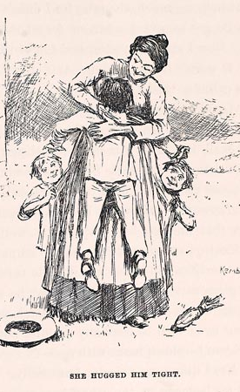
Chapter 32 – Arriving at the Phelps Farm
Small plantation resembling Twain’s uncle’s farm
“Aunt Sally” was expecting a boy Huck’s age
Huck plays along until she introduces him to her husband as Tom Sawyer
He knows plenty about Tom’s family and is able to continue with his lies
“Feeling pretty comfortable all down one side, and pretty uncomfortable all up the other.”

Slide 3
Chapter 33 – Tom’s Arrival
Huck and Tom reunited
Of course, they go right back to playing Tom’s games
Tom was the original leading man
He is representative of respectable society
Huck has always deferred to Tom
Tom pretends to be a stranger, then pretends to be his brother Sid

Slide 4
Dinner Conversation – Mention of “the show”
Even after all they’ve done to him, Huck wants to warn the duke and king
Huck feels sorry for them when he sees them tarred and feathered

Slide 5
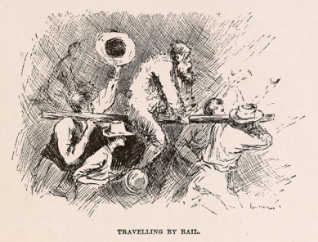
Traveling by Rail

Slide 6
Chapter 34 – Tom Will Help Huck
Huck and Tom discover Jim’s location “detective fashion”
Again, Huck praises Tom’s “genius”
Huck can’t believe Tom will help him “steal” Jim, but Tom insists…

Slide 7
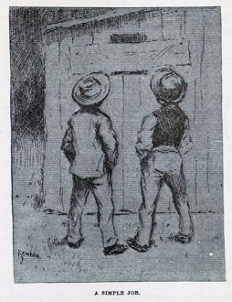
Tom’s embellishments
Huck sees practical solutions, but Tom “should hope we can find a way that’s a little more complicated than that, Huck Finn”
Uh-oh. We can see where this is heading…

