Slide 1
Pride and prejudice ch. 25-29
Discussion Guide

Slide 2
The gardiners
Who are they?
What does Mrs. Bennet say to Mrs. Gardiner about Jane and Elizabeth?
What does Mrs. Gardiner suggest might help Jane?
    Do you foresee any potential problems with this plan?
What has Mrs. Gardiner heard about Darcy?
What does Mrs. Gardiner warn Elizabeth about with regard to Wickham?
  What does Elizabeth’s response reveal?

Slide 3
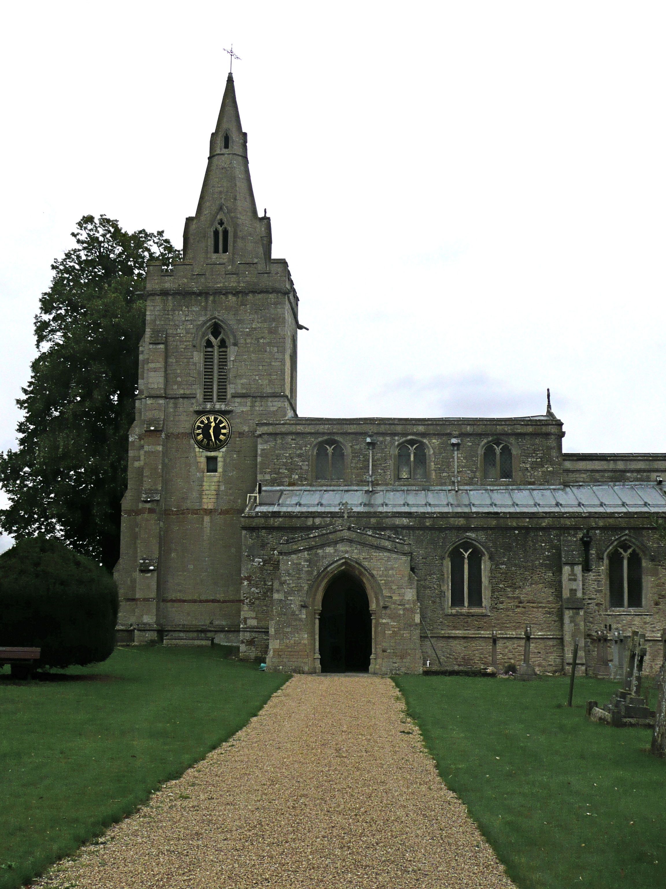
Charlotte’s request
What does Charlotte request of Elizabeth?
How has their relationship changed?

Slide 4
Caroline bingley
How does Caroline react when Jane pays a visit in London?
How does Elizabeth interpret this?
What does Jane reveal in her next letter?
Who does Jane believe Mr. Bingley will soon marry?
How does Elizabeth receive this news?

Slide 5
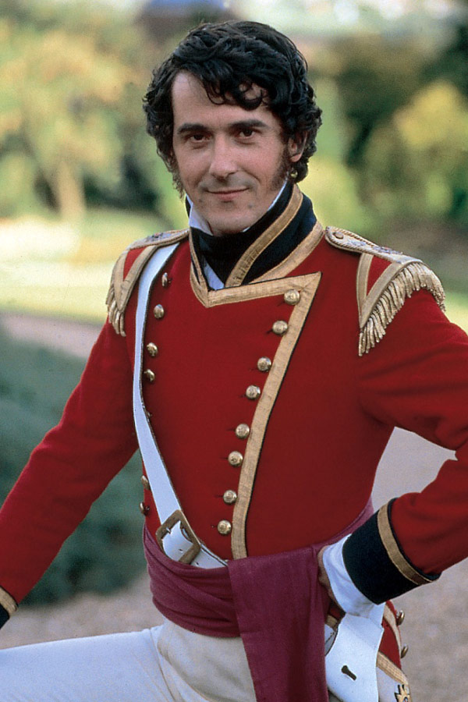
Mr. wickham
Who is he interested in now?
How does Elizabeth react to this knowledge?
What does this tell us about her character?

Slide 6
On the road to hunsford
Who does Elizabeth travel with?
  How does she feel about them?
Why is she looking forward to this trip?
  Who is she excited to see?
Explain Elizabeth’s comments about Wickham on p. 131
How does Elizabeth feel about Miss King?

Slide 7
Elizabeth’s feelings on love…
“Oh! If that is all, I have a very poor opinion of young men who live in Derbyshire; and their intimate friends who live in Hertfordshire are not much better. I am sick of them all. Thank Heaven! I am going tomorrow where I shall find a man who has not one agreeable quality, who has neither manner nor sense to recommend him. Stupid men are the only ones worth knowing, after all” (Austen 132).
What trip does she look forward to at the end of chapter 27?

Slide 8
Arriving at hunsford
How is Hunsford described?
How does Charlotte react to Mr. Collins’ frequently embarrassing comments?
What is Mr. Collins most proud of?
What event has the household in an uproar?

Slide 9
Anticipating lady catherine
Maria is frantic
Mr. Lucas is uneasy
Elizabeth is told to wear “whatever of [her] clothes is superior to the rest.”
Is Elizabeth worried?

Slide 10
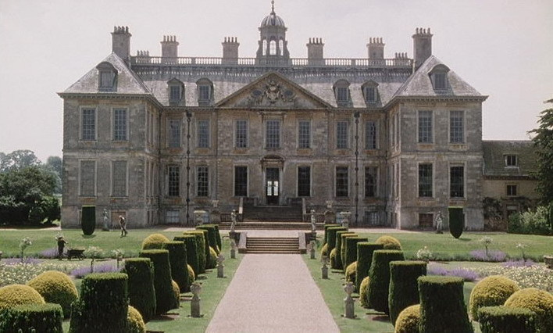
Lady de bourgh’s visit
What is Elizabeth’s judgment of Lady Catherine?
How does Lady de Bourgh spend the evening?
Note Austen’s sense of humor at the end of chapter 29.

